Slide 1
Positive Behaviour Supports
Environmental / Ecological Factors

Slide 2
Functional Behaviour Assessment Steps
Decide if a intervention is warranted
Develop a personal profile
Define the target behaviour
Conduct a functional behaviour interview
Conduct direct observations
Use setting events checklist
Form hypothesis
Design an support plan (prevent, teach and respond)
Evaluate plan

Slide 3
A simplified way of framing the assessment and intervention process
Antecedent | Behaviour | Consequence
Proactive | Teach | Response
You!

Slide 4

Educator changes
Physical Setting
Social Setting
Degree of Independence
Degree of choice

Slide 5
Ecological considerations
Refers to the environment in which the student is learning:
Classroom environment
Schedules & rules
Room arrangement for instruction and materials management
Student seating arrangements
Plans for transition between activities and settings
Curricular and instructional approaches

Slide 6
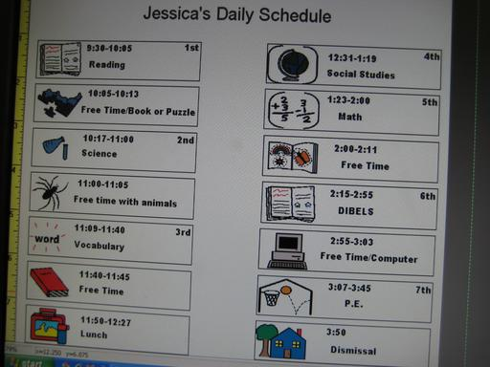
Environmental Factors
Scheduling factors
Poor sequencing
Unexpected changes
Transitions
Absence of visual supports

Slide 7
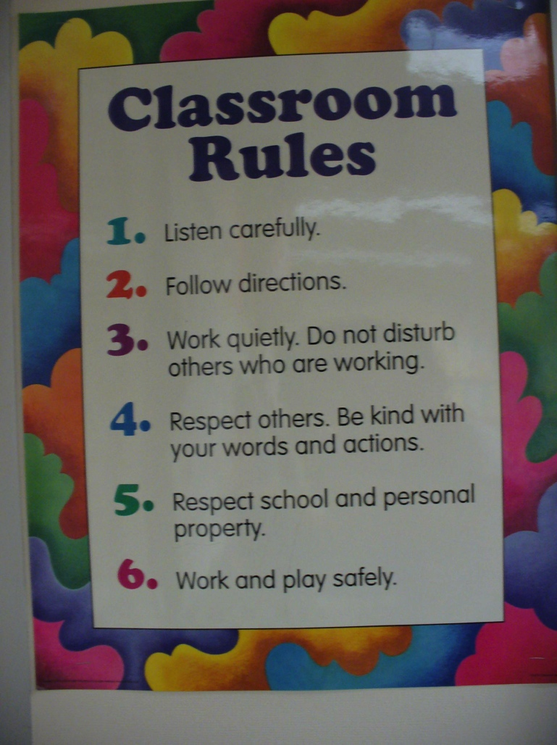
Classroom rules
Promote
consistency and
structure:
School wide
Classroom schedule
Individual student schedules
Classroom rules

Slide 8
Room arrangement
Maximize ability to monitor students
Decrease noise and disruption
Increase students’ on-task behaviour
Minimize distractions
Encourage students to interact with each other and the educators
Allow students easy access to materials

Slide 9

Student Seating Arrangements
Proximity to teacher
Proximity to other students
Proximity to distractions
Instructional formats
Individual
Large Group
Cooperative

Slide 10

Transitions
Develop consistent transitions
Give notice before the transition must be made
Review individual schedules after each activity or period
Organize materials for activities and make them accessible
Support students with desk and binder organization

Slide 11
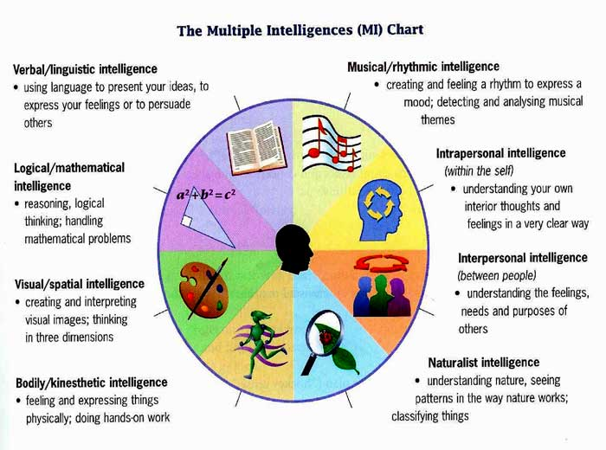
Curricular & Instructional Approaches
Use multiple modalities
Conduct personal profile
Implement differentiated instruction approaches: determining what to teach, how information is presented and how students show their learning.

Slide 12
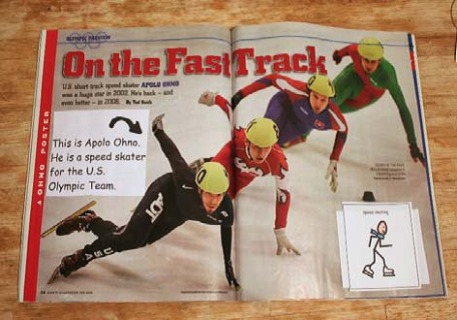
Curricular & Instructional Approaches
Adapt and / or modify curriculum:
Change amount of work or time
Change the appearance of assignments
Pace instruction
Provide an alternative time to complete assignments

Slide 13
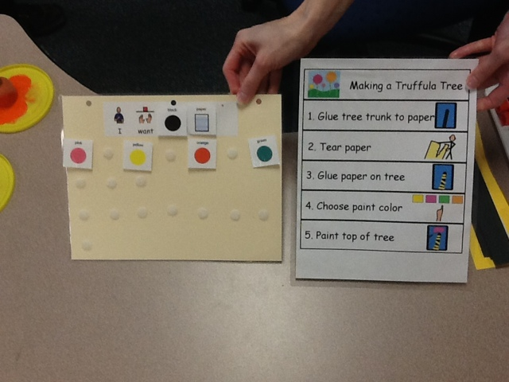
Curricular & Instructional Approaches
Adapt and / or modify curriculum:
Change difficulty (and still keep the same outcome for the activity)
Change form of output
Provide peer support

Slide 14
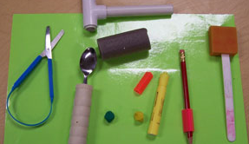
Adaptive Devices

Slide 15

Design & Formatting

Slide 16

Interactive Style
Consider your:
Tone of voice
Body posture
Belief in student
Language to describe student and to give instructions
Use of control

Slide 17

Authoritarinism
Attitude characterized by:
“I am here to teach you the rule”
Compliance is the typical form of interaction
Focus on learning what not to do, rather than what to do

Slide 18
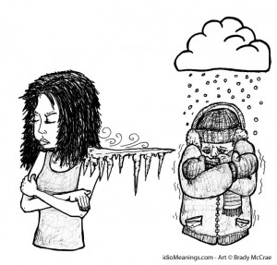
Coldness
Attitude characterized by:
Minimal interaction
Basic custodial care (providing food, shelter)
Its just a job, a routine to get through
Little belief in the student and their abilities

Slide 19
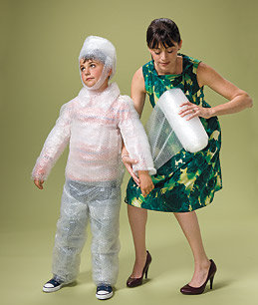
Overprotection
Attitude characterized by:
Implied warmth but really it’s pity and minimal expectations
Fosters dependency
The educator often resolves each difficulty (doing the work for the student, denying them the opportunity to learn and develop - even if it means making mistakes)

Slide 20

Solidarity
Attitude characterized by:
Respect for the student
Safety and rules are accomplished without smothering or excessive control
Focus is on development of the learner and educator

Slide 21
A simplified way of framing the assessment and intervention process
Antecedent | Behaviour | Consequence
Proactive | Teach | Response
You!

Slide 22

Educator changes
Instructional strategies, curriculum and activities
Scheduling factors
Interactive Style

Slide 23
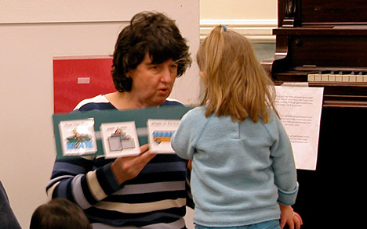
Educator changes
Environmental changes:
Physical Setting
Social Setting
Degree of Independence
Degree of choice

